Slide 1

Linked List (Contd)
Dr. Ashik Ahmed Bhuiyan
Many of the slides were adopted from Dr. Si Chen

Slide 2
Review
2

Slide 3
Adding an Element at a Given Index
Check index: if out of bounds, throw an exception.
Is index = 0? Put new element at beginning of the list.
Is index > 0? Skip index nodes from beginning of the list and splice in the new node.
Implementation????
2

Slide 4
Removing a List Element Based on Value
Use a list traversal to locate the node containing the given value, return false if there is no such node.
If the target node is the first node, remove it by moving first forward and then return true.
Otherwise, find the predecessor of the target node and remove the target node.
6

Slide 5
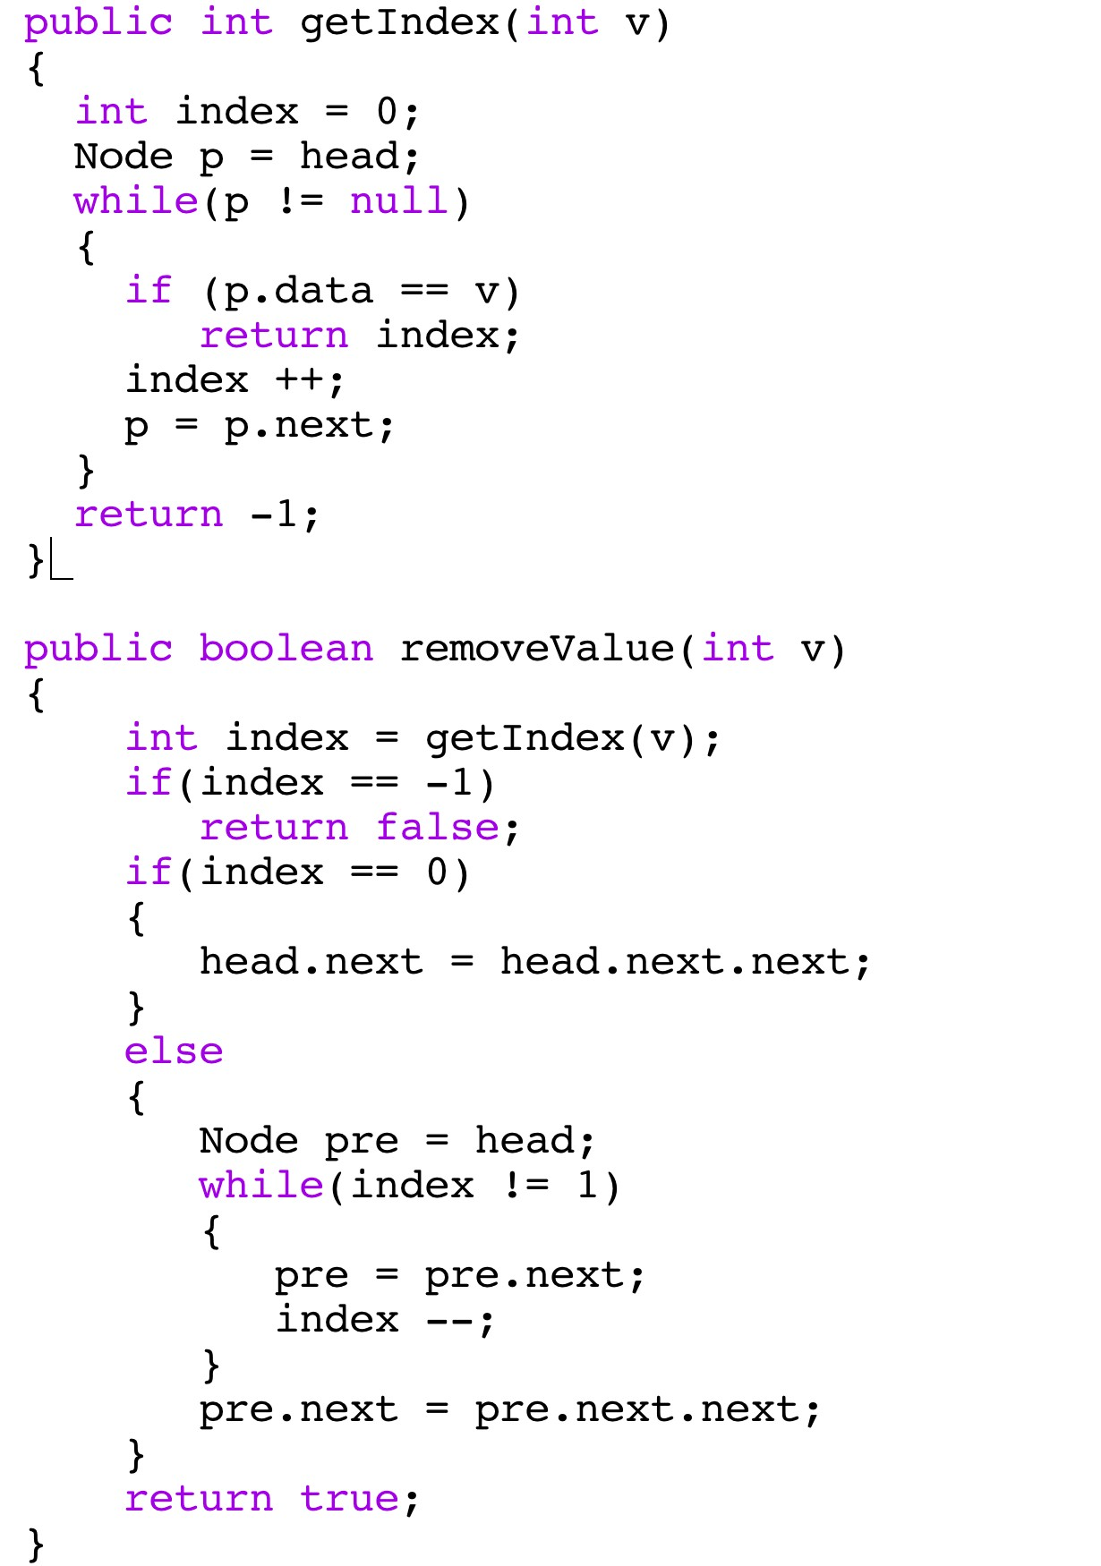
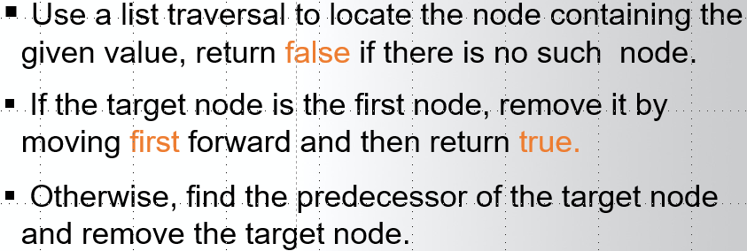

Slide 6
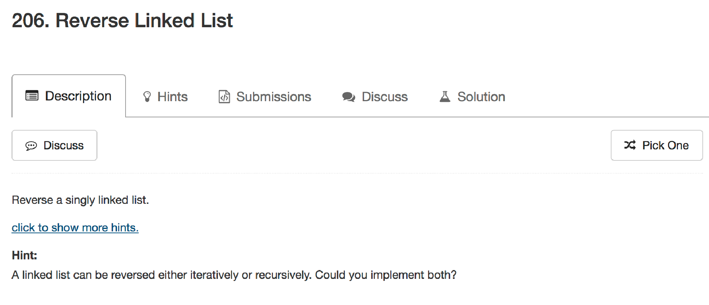

Slide 7

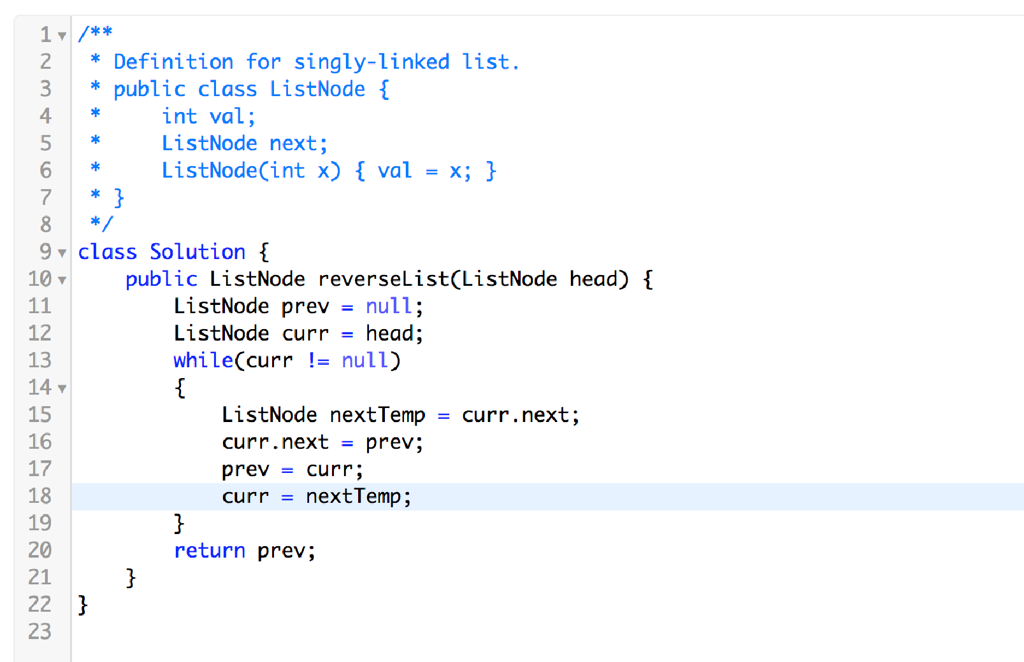
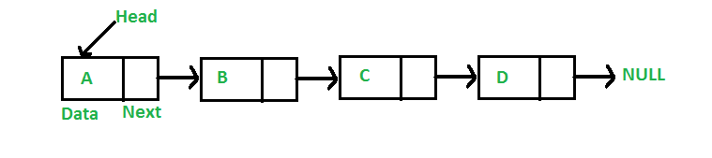
206. Reverse Linked List
Try to visualize what will happen

Slide 8
Doubly Linked Lists
Singly-linked lists allow one way traversal: one can move from a node to its successor.
Limitation: one cannot easily move from a node to its predecessor.
Doubly-linked lists allow easy transitions in both directions.
Has links to both previous and next nodes
Faster (bi-directional) traversal, but, more control data (links) stored

Slide 9

Nodes for Doubly Linked Lists
A node for a doubly linked list must have both a successor link and a predecessor link:

Slide 10
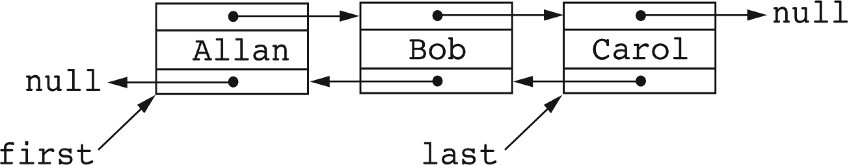
Doubly-Linked Lists
Can be represented by a head (first) reference and a reference to the last node (for efficiency)

Slide 11
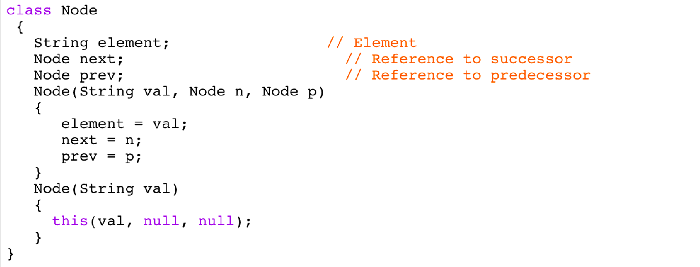
Node Class for Doubly-Linked Lists

Slide 12
Operations on Doubly-Linked Lists
Implementations of size(), isEmpty() are similar to those of singly-linked lists
Addition and removals are also similar, but require care to manipulate the two links for successor and predecessors.

Slide 13
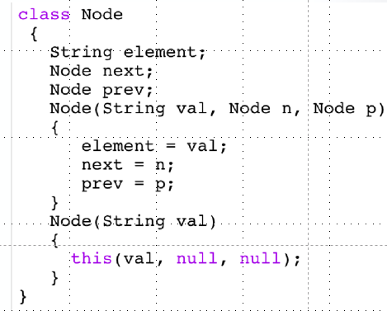
Addition at beginning of a doubly linked List
To add a new element e to an empty list: first = new Node(e, null, null);
last = first;
To add e to beginning of a nonempty doubly linked list:
first = new Node(e, first, null); first.next.prev = first;

Slide 14
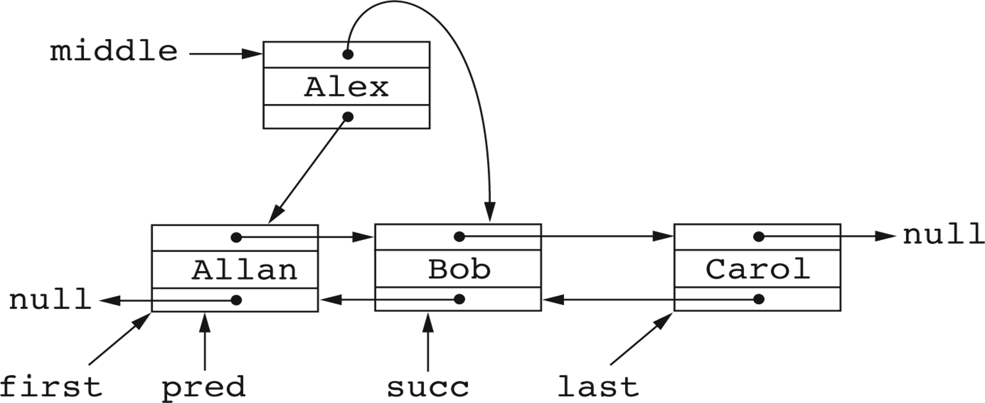
Addition After the First Element
Set pred to what will be predecessor of the new node.
Set succ to what will be the successor of the new node.
Put the new node in the middle (between) pred and succ.

Slide 15
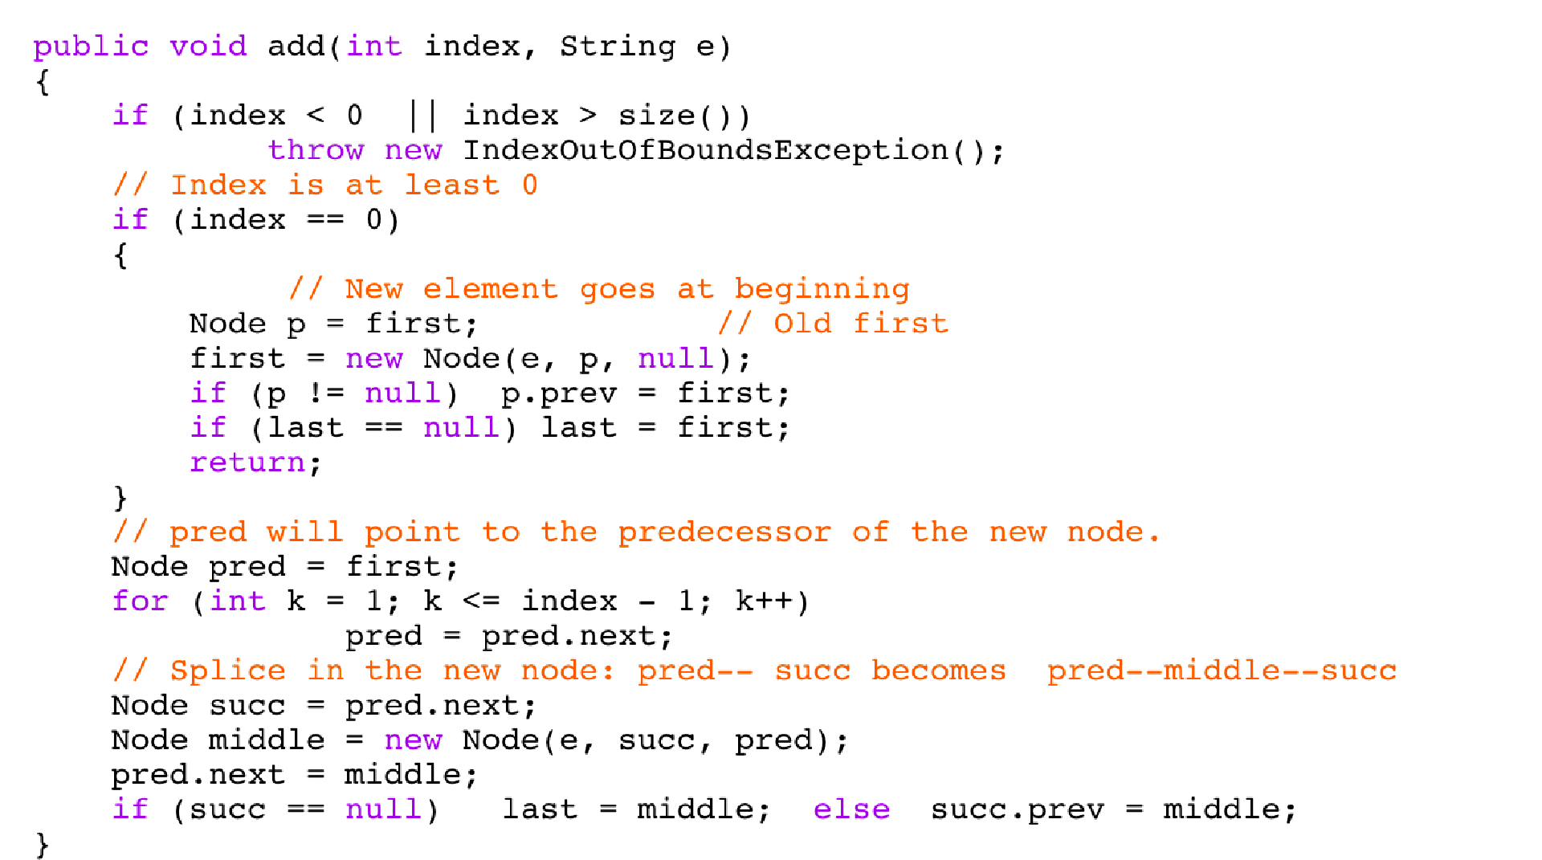

Slide 16
Recursion on Linked Lists

Slide 17
Recursion on Singly-Linked Lists
Recursion is natural on lists for many reasons:
The empty collection is a list.
A non empty list consists of a head (the first element) and a tail.
The tail of a list is also a list.

Slide 18
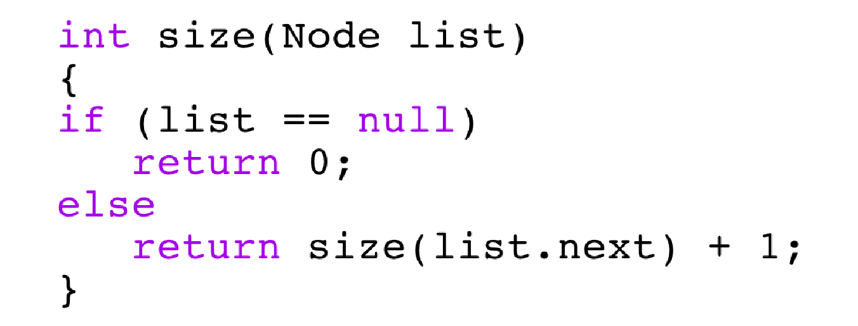
Recursive Implementation of size
A private int size(Node list) method for computing the size of a list:
The size of an empty list is 0.
The size of a non empty list is one greater than the size of the tail:
size(list.next) + 1.
Base Case
Recursive Case

Slide 19






